Slide 1
Cracked vs. healthy teeth classification via functional data analysis
Client: Beatriz Paniagua, Jared Vicory
Consultant: Angel Huang
Professor: Dr. Steve Marron
2020/9/28

Slide 2


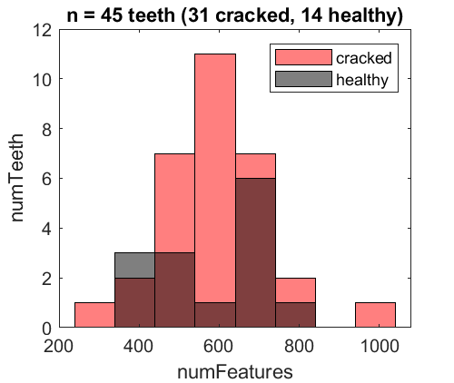
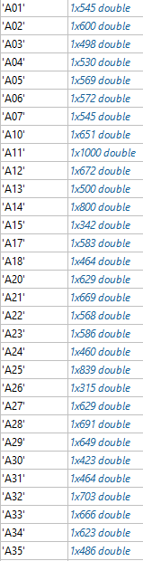
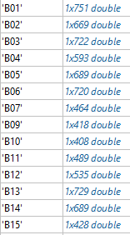
Dataset
N = 45 teeth (31 cracked + 14 healthy)
Each tooth has different number of features (i.e. pixel clusters)
Cracked teeth have broader spread of (and overlapping) number of features than healthy teeth -- not helpful
Min number of features is 315, max is 1000.

Slide 3
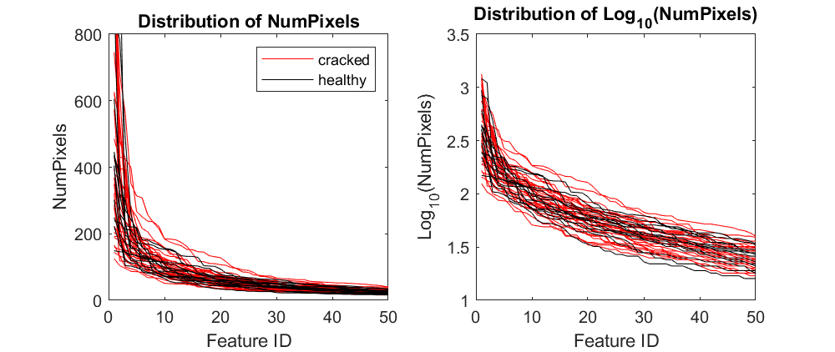
1_rawTrace
Overlapping distribution of numPixel for cracked and healthy teeth
Log scale seems more sensible, but doesn’t differentiate the two teeth types either

Slide 4
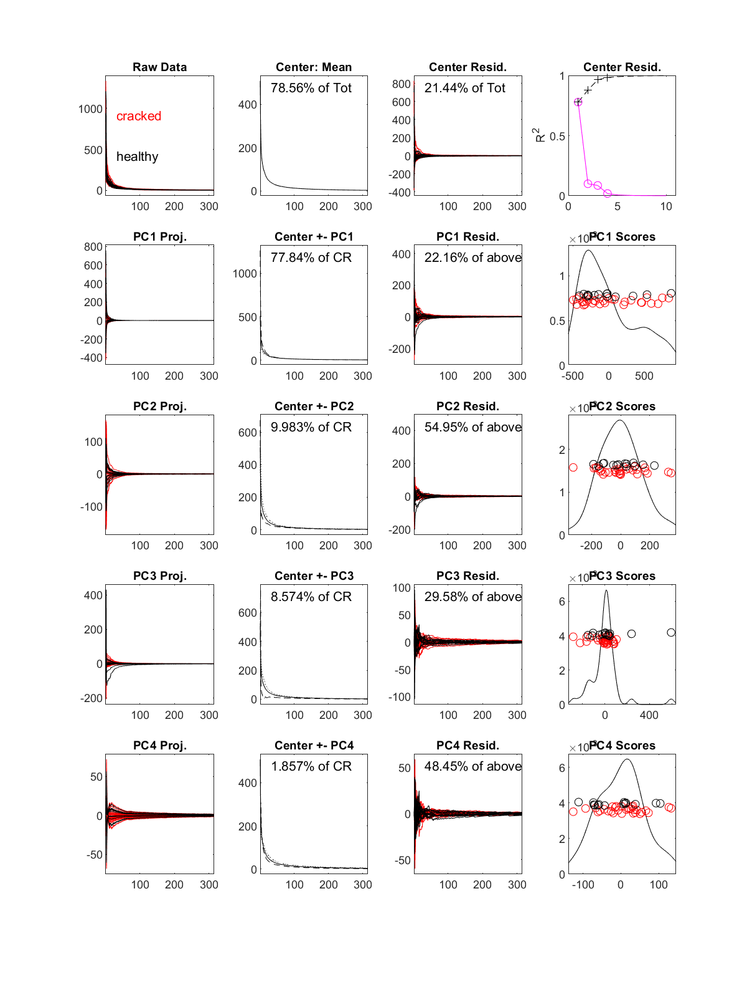
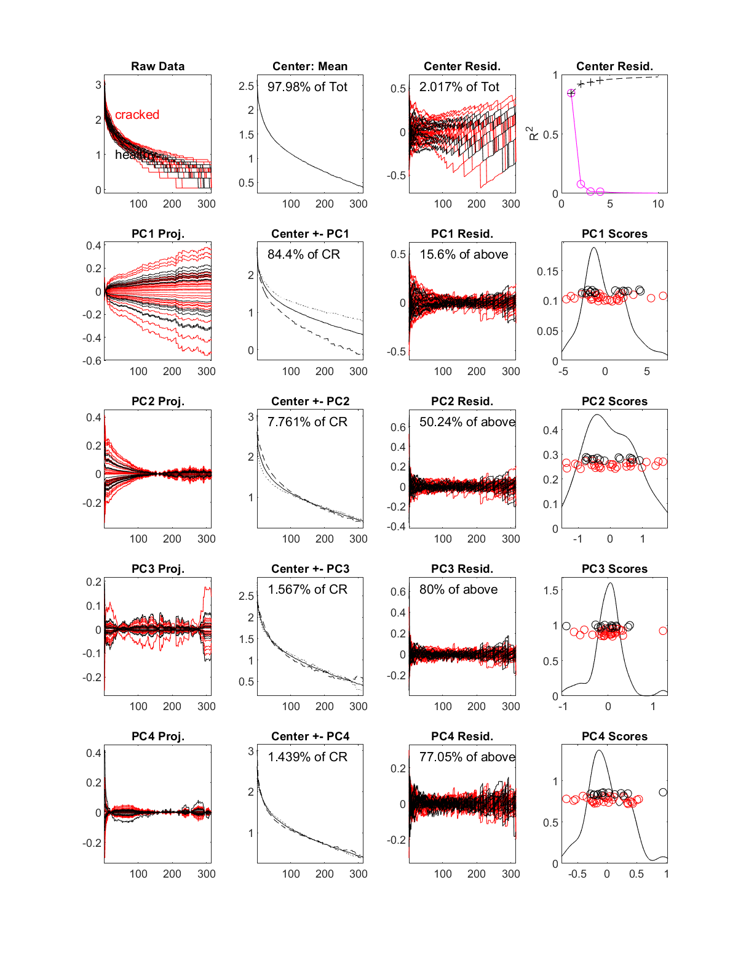
Original data
Log10(data)
2_curvdatPlot
-- don’t see much trend
-- log scale is more informative

Slide 5
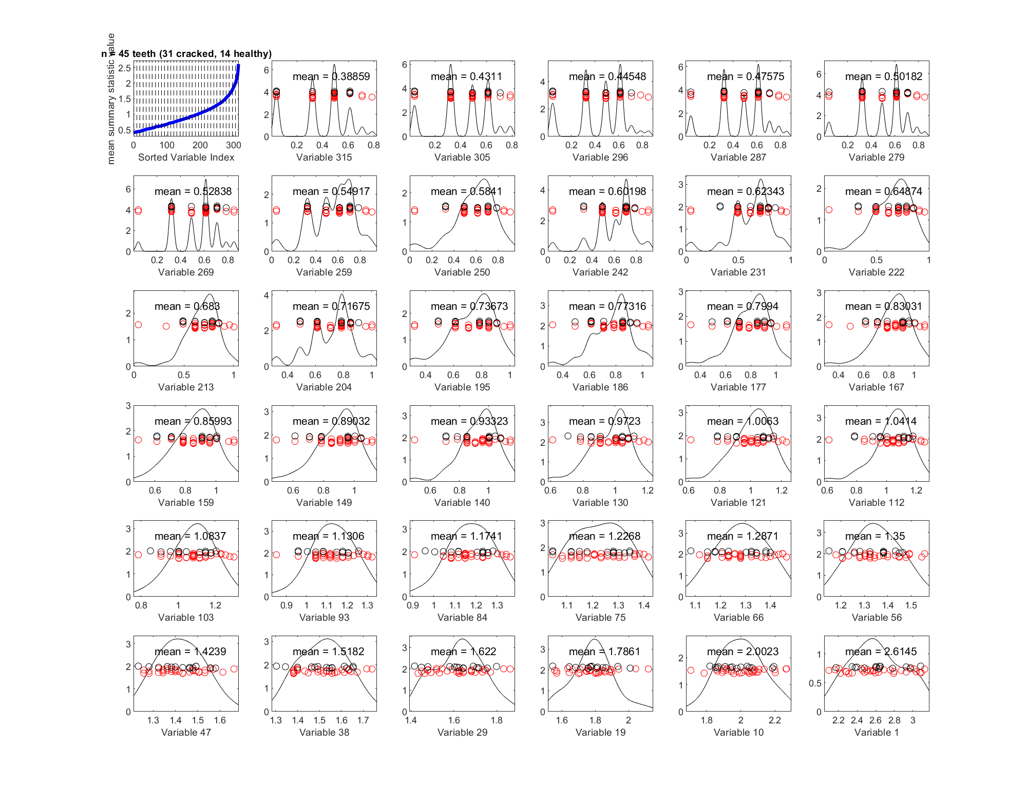
3_margDistPlot
Marginal distribution plot on log10(numPixel)
Truncated each sample to the minimum number of features = 315
Summary statistics of mean
-- hard to separate 2 classes

Slide 6
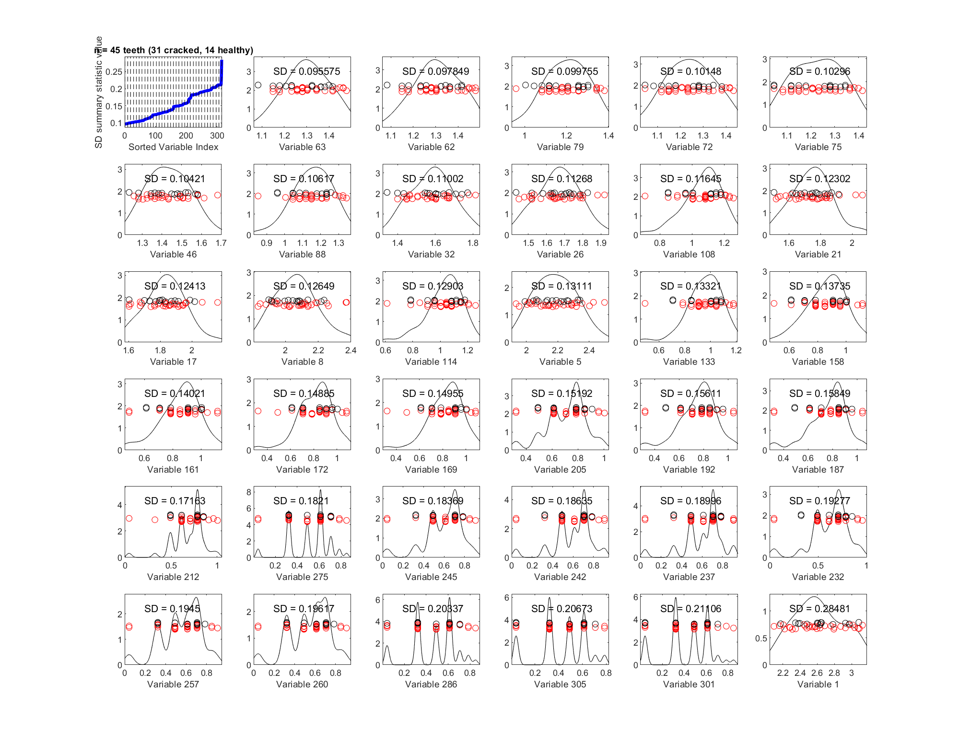
3_margDistPlot
Marginal distribution plot on log10(numPixel)
Truncated each sample to the minimum number of features = 315
Summary statistics of standard deviation
-- hard to separate 2 classes

Slide 7
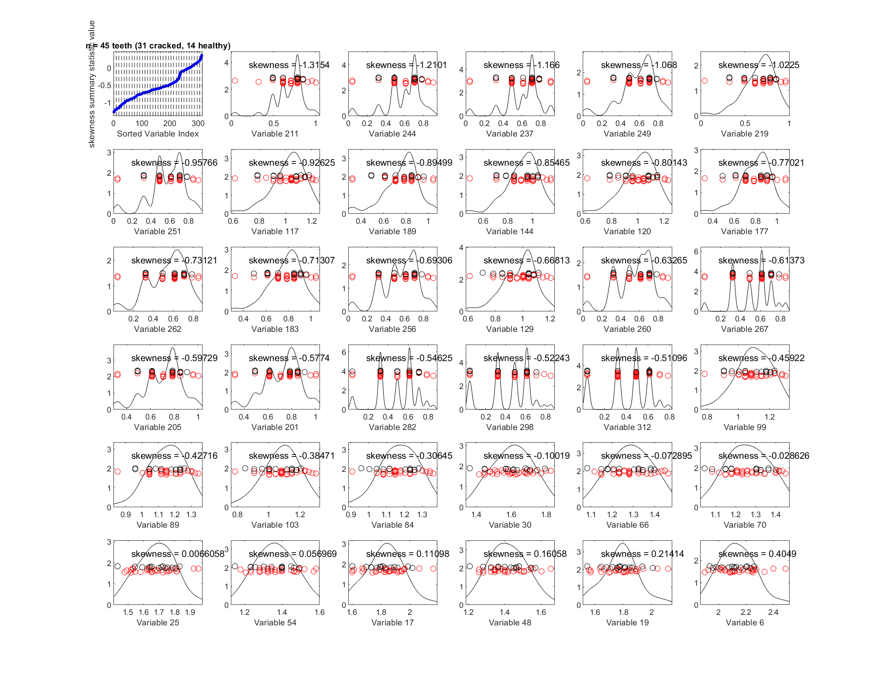
3_margDistPlot
Marginal distribution plot on log10(numPixel)
Truncated each sample to the minimum number of features = 315
Summary statistics of skewness
-- hard to separate 2 classes

Slide 8
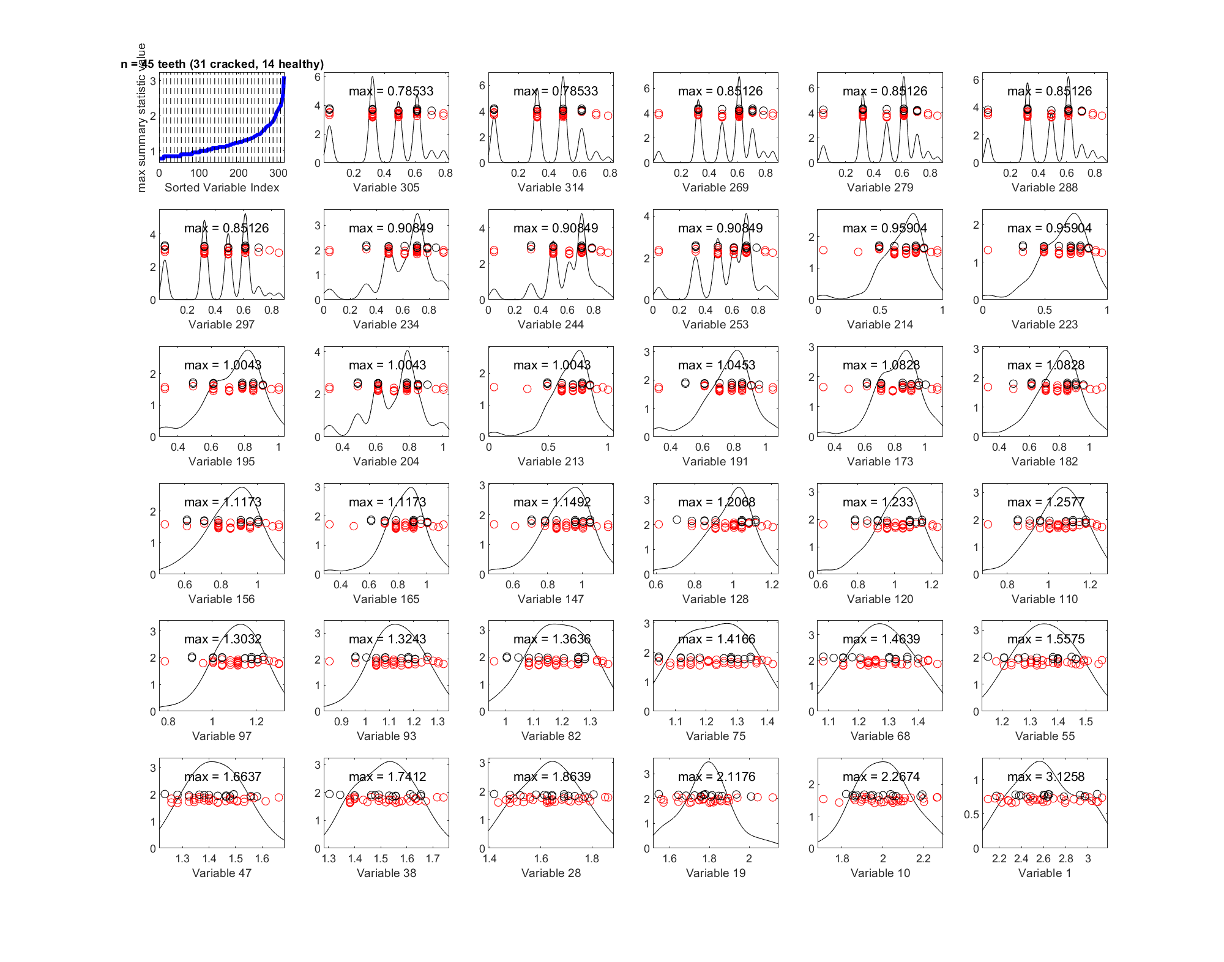
3_margDistPlot
Marginal distribution plot on log10(numPixel)
Truncated each sample to the minimum number of features = 315
Summary statistics of max
-- hard to separate 2 classes

Slide 9
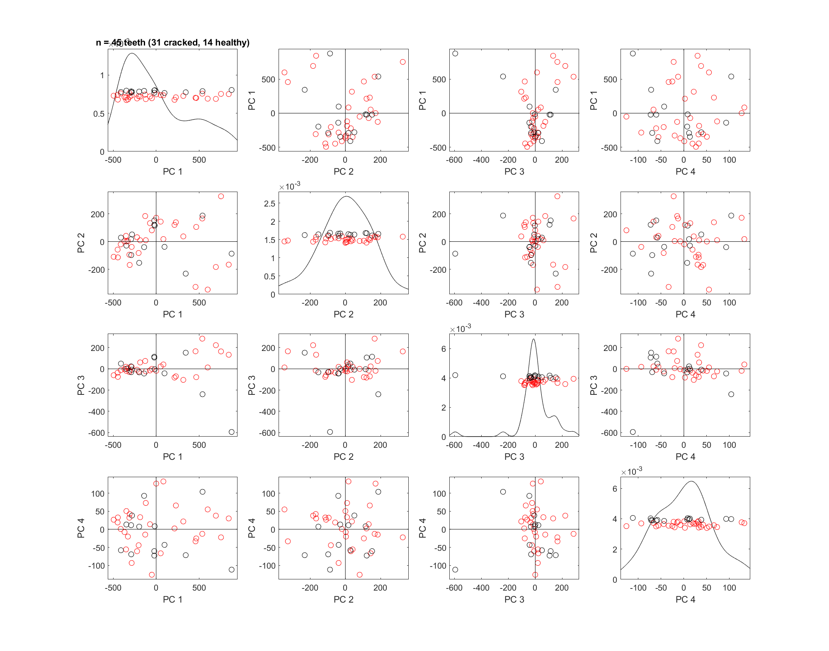
4_PCAScatPlot
rawData
Truncated each sample to the minimum number of features = 315
-- 4 PCs don’t seem to separate the 2 classes

Slide 10
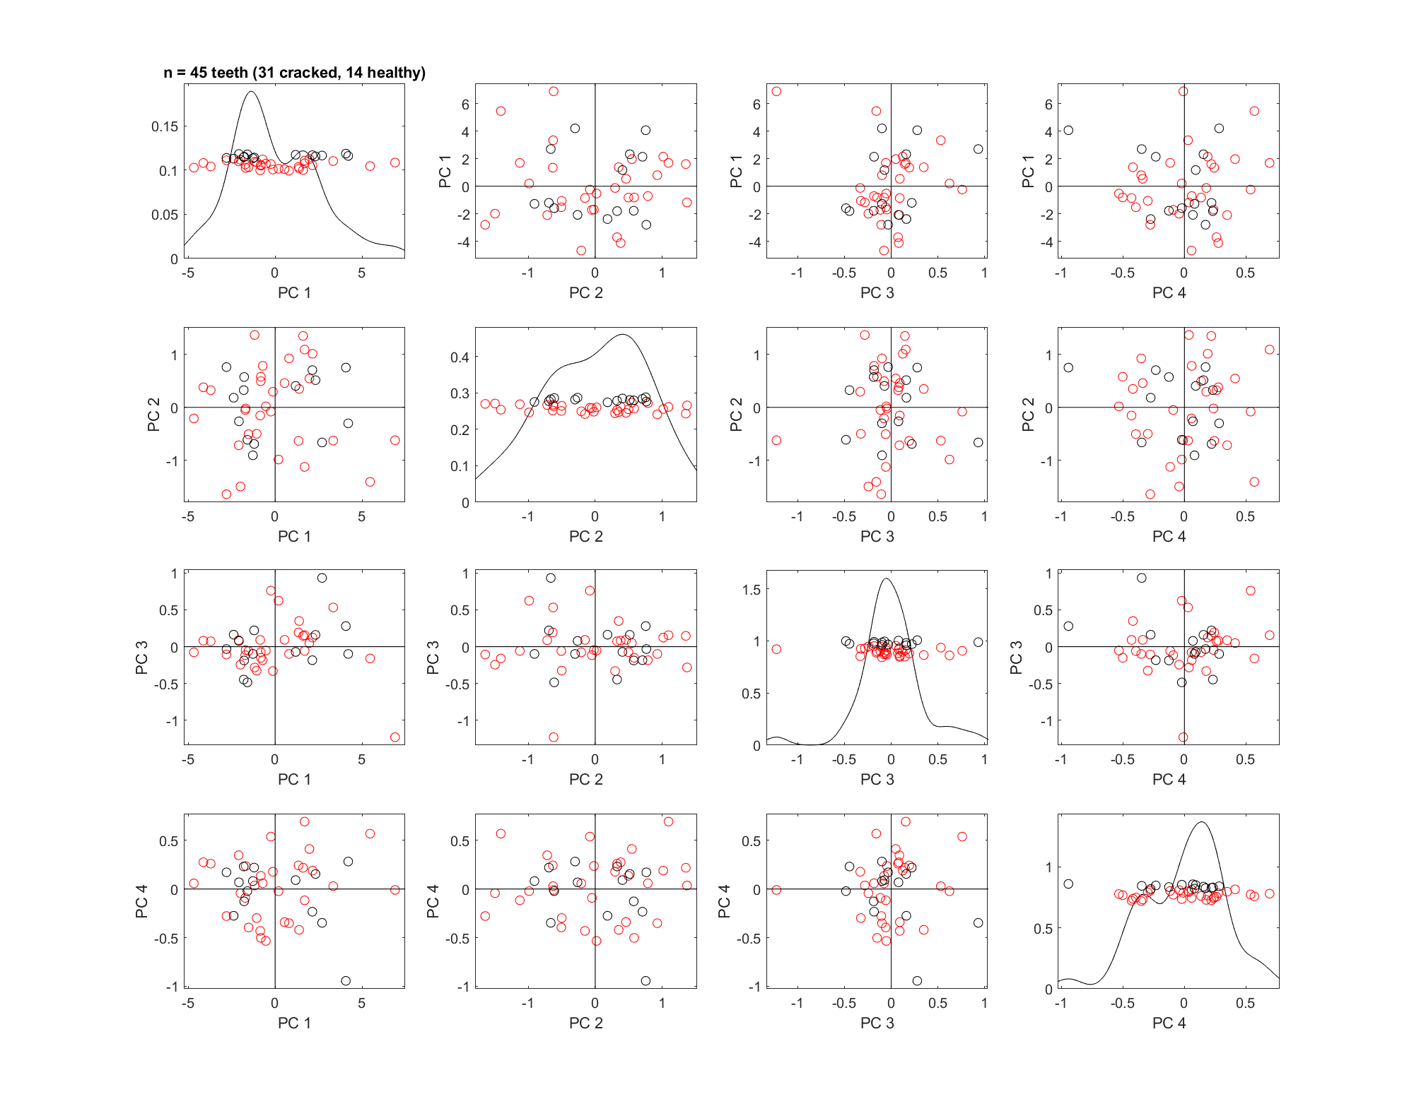
4_PCAScatPlot
log10(numPixel)
Truncated each sample to the minimum number of features = 315
-- 4 PCs don’t seem to separate the 2 classes
Also tried using 600 features and 1000 features (with 0-padding), none show obvious separation of the 2 classes

Slide 11
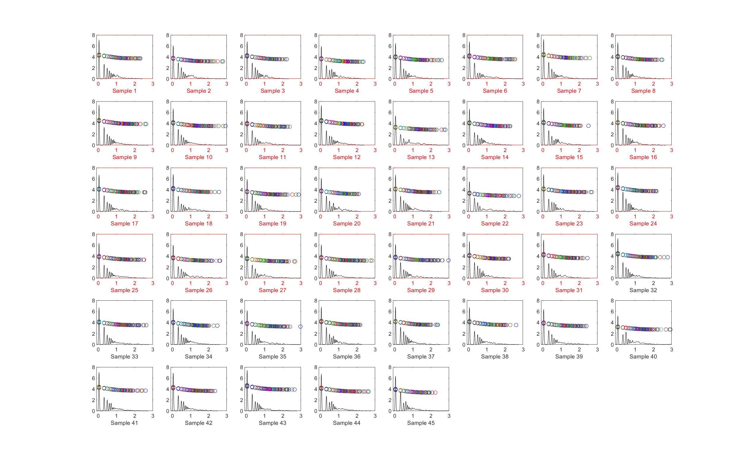
5_projPlot
log10(numPixel) projection (distribution) plot
-- go to next slide to zoom in
Red: cracked
Black: healthy

Slide 12
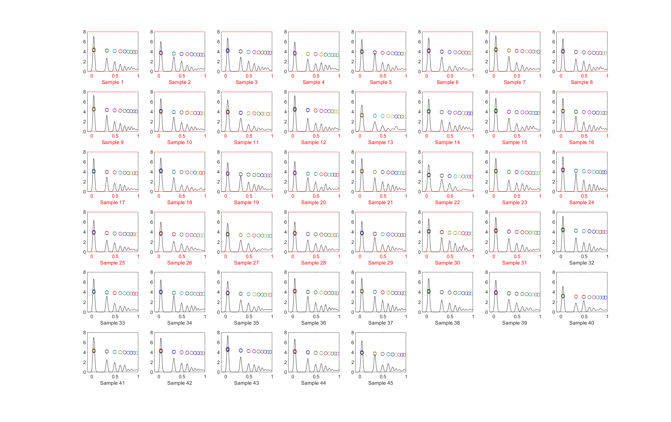
5_projPlot
log10(numPixel) projection (distribution) plot
Zoom in to [0,1] to see pattern of larger pixel clusters
Red: cracked
Black: healthy
-- 1st peak is around 6~7
-- 2nd peak is around 2~4
-- can’t see difference between classes by eye

Slide 13
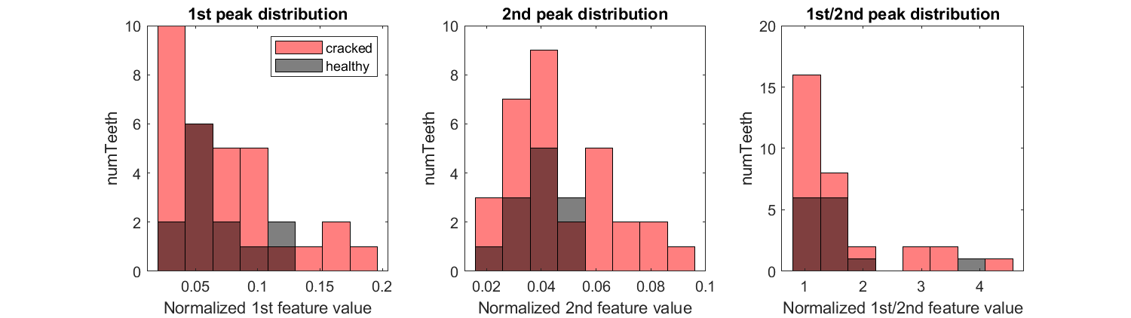
Exploratory plot:
1st peak distribution:
2nd peak distribution
ratio of 1st /2nd peak distribution
Overall, still much overlap between the 2 classes

Slide 14
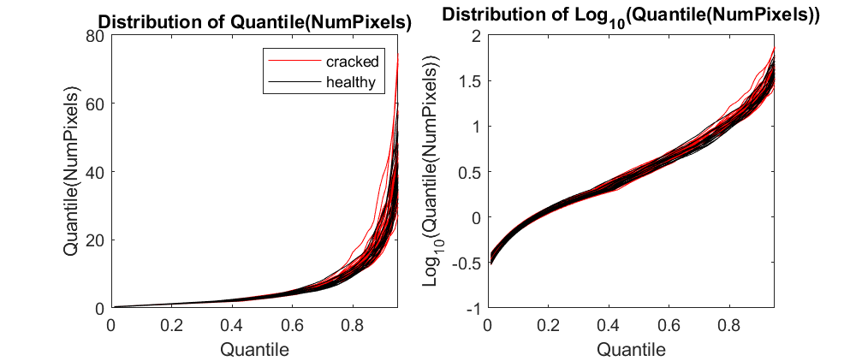
From now on, use quantile to represent each curve
21_rawTrace
Still overlapping distributions
numQuantiles=100

Slide 15
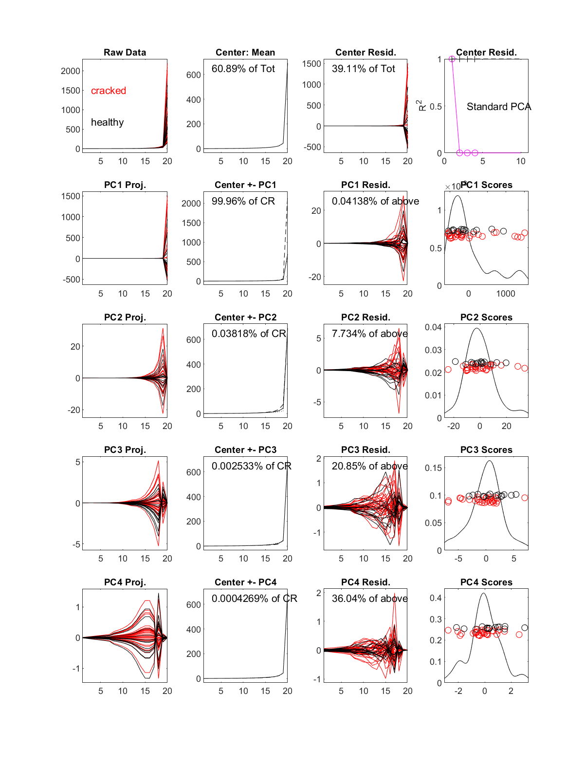
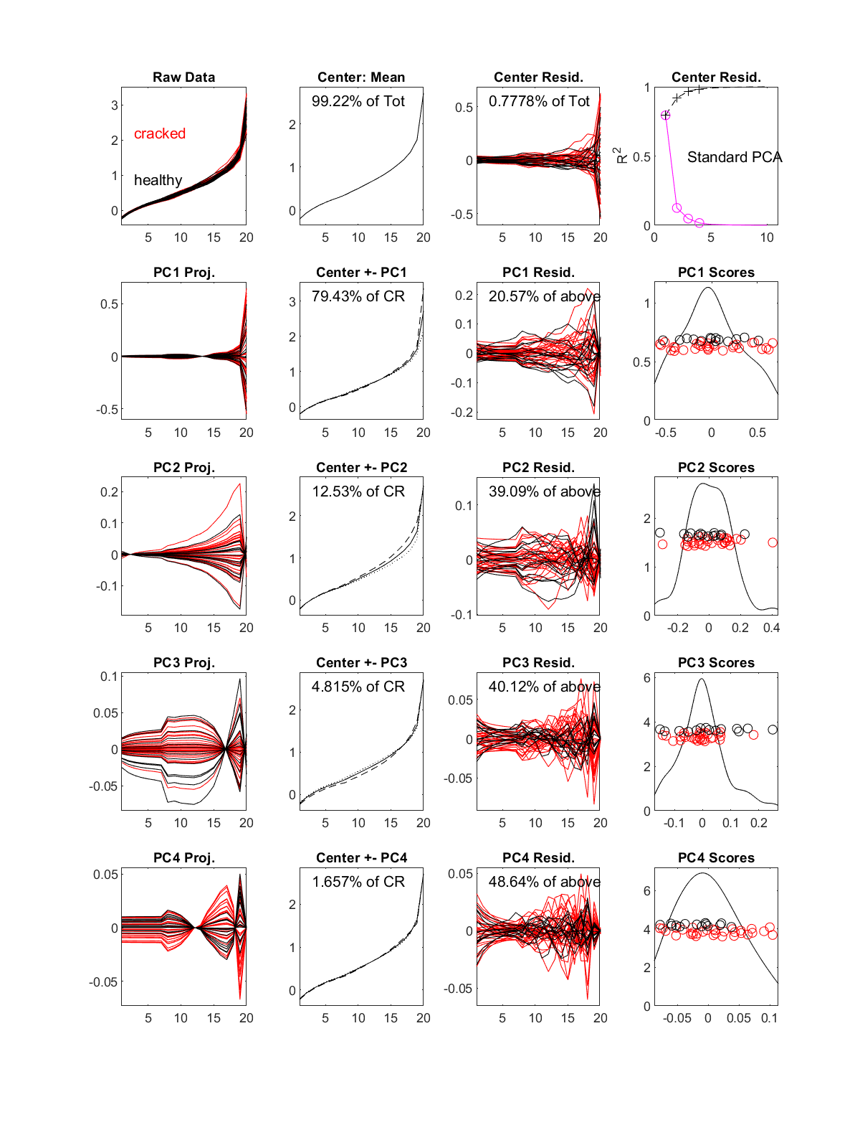
Original quantile
Log10(quantile)
22_curvdatPlot
-- don’t see much trend

Slide 16
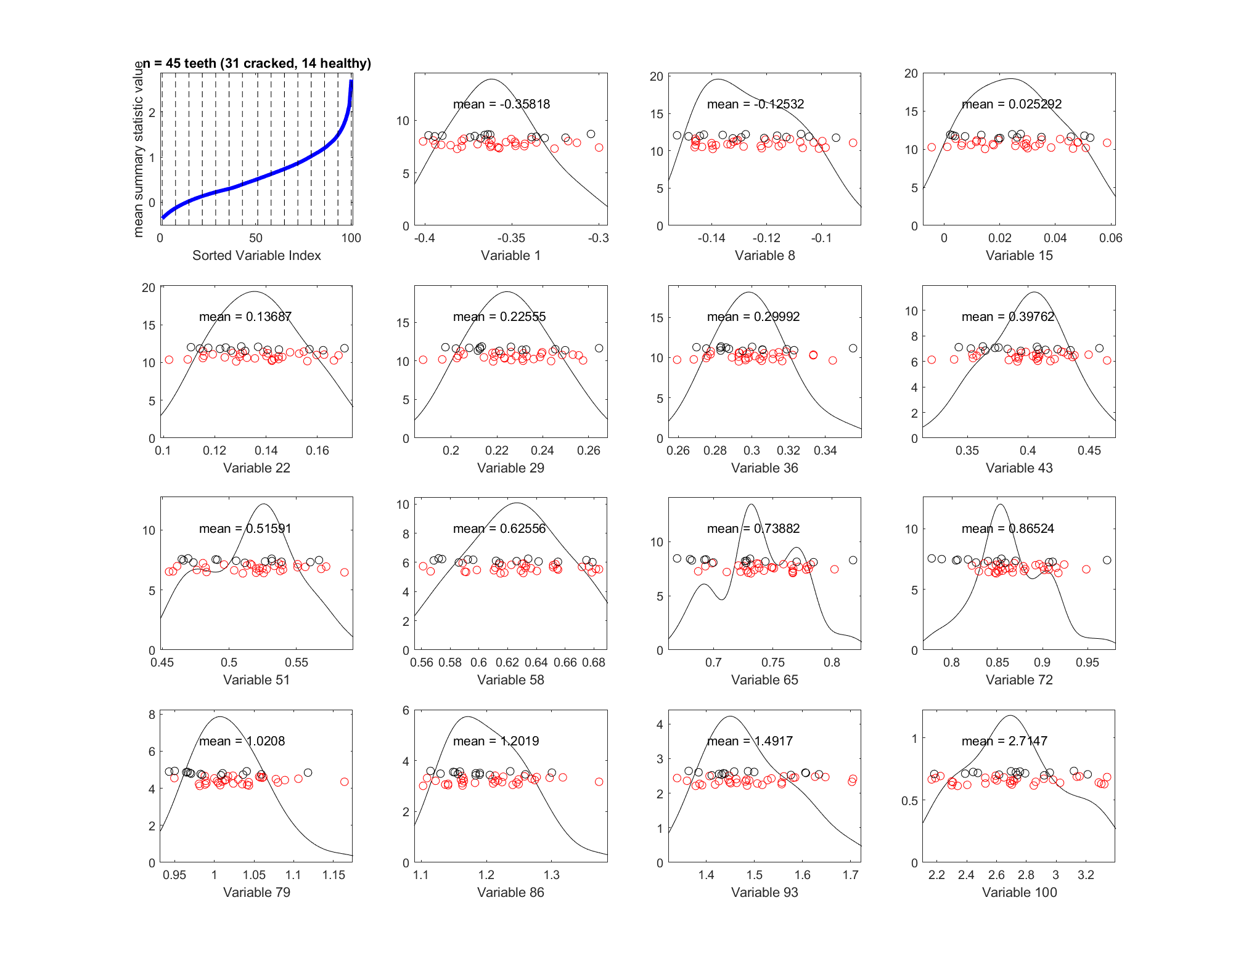
23_margDistPlot
Marginal distribution plot on log10(quantile)
Use quantiles as features,
number of features = 100
Summary statistics of mean

Slide 17
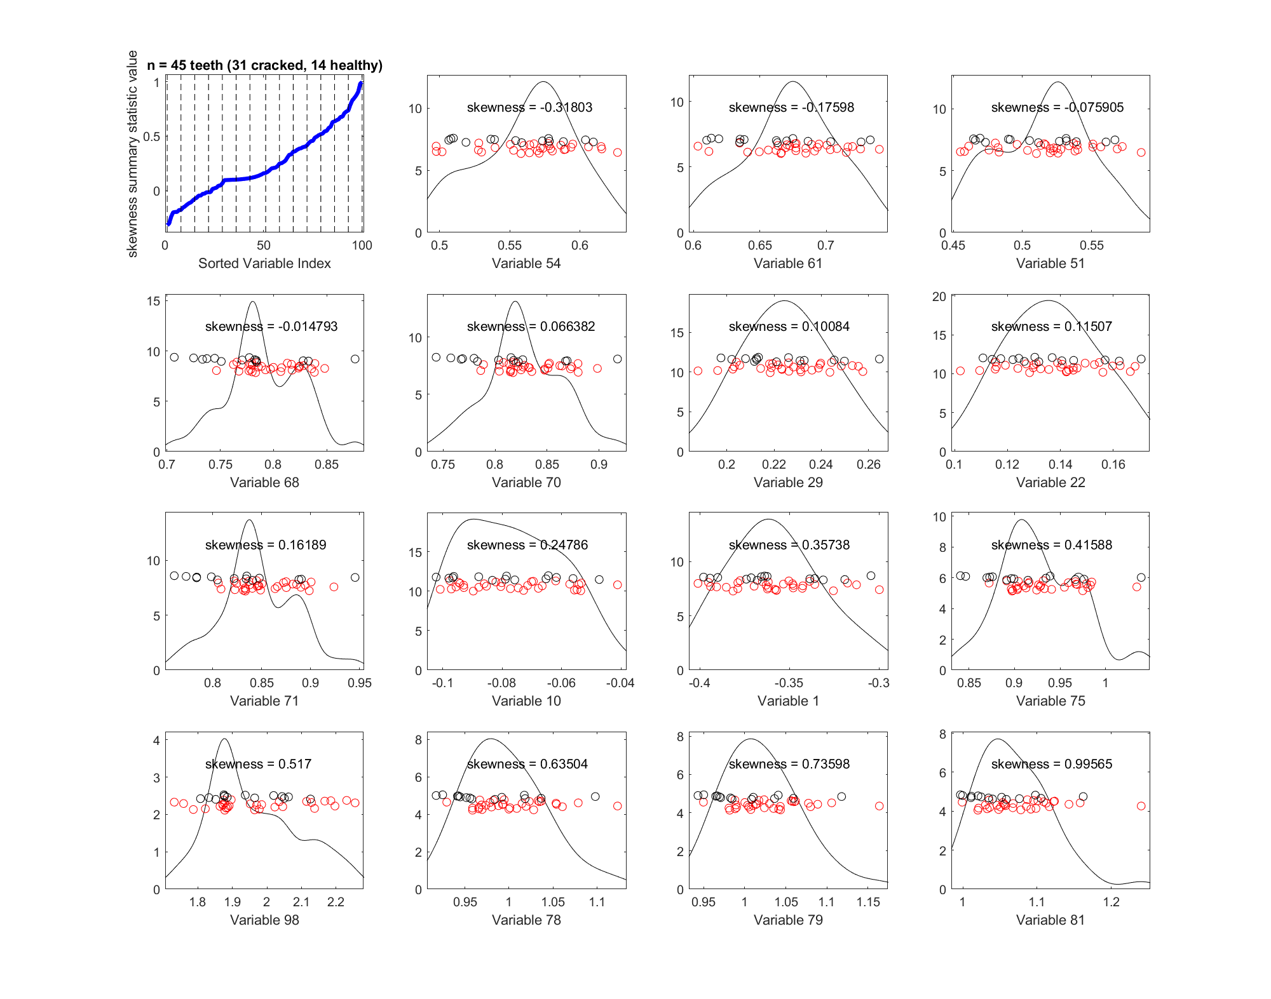
23_margDistPlot
Marginal distribution plot on log10(quantile)
Use quantiles as features,
number of features = 100
Summary statistics of skewness
-- hard to separate 2 classes

Slide 18
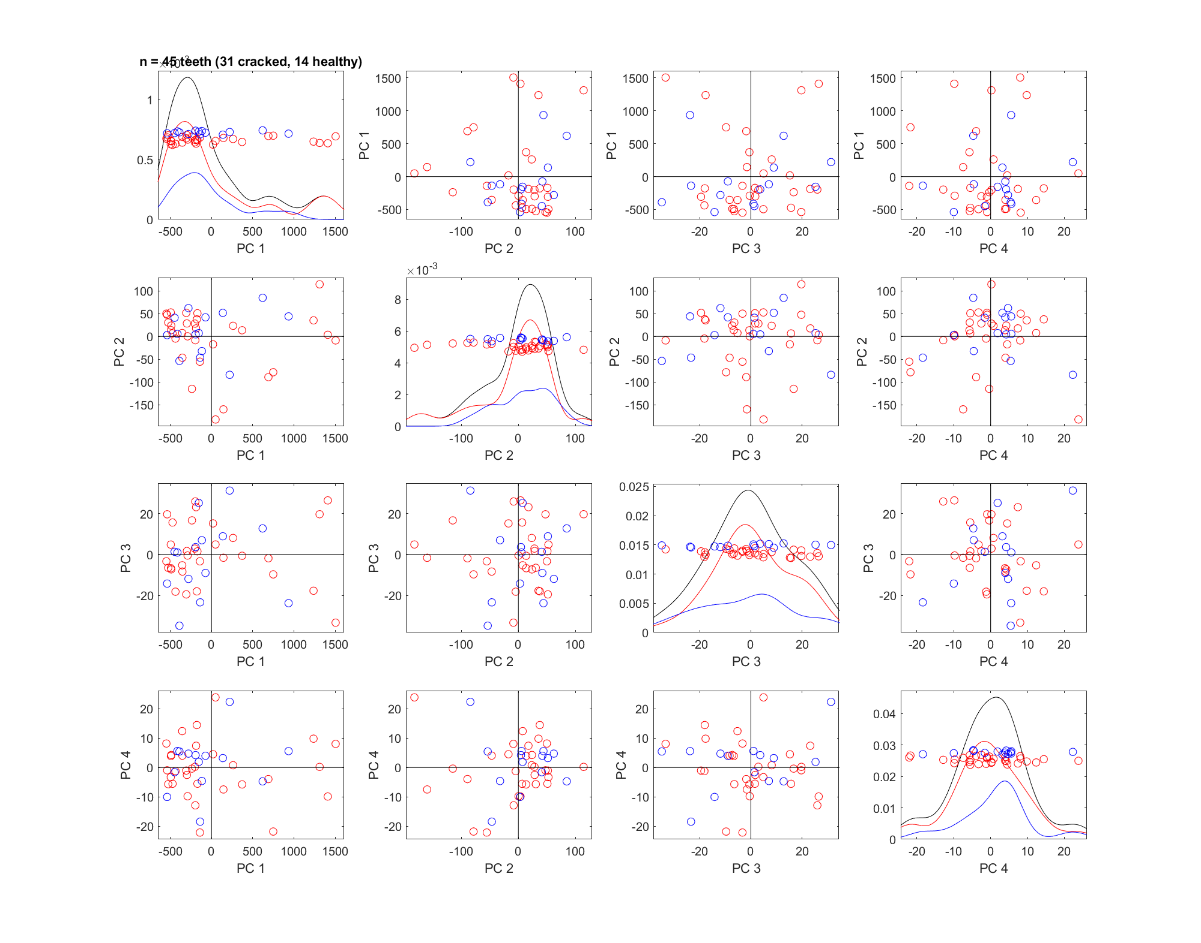
24_PCAScatPlot
quantile
Use quantiles as features,
number of features = 100
-- use isubpopkde=1 to show curve for each class
-- Maybe some separation in PC4?

Slide 19
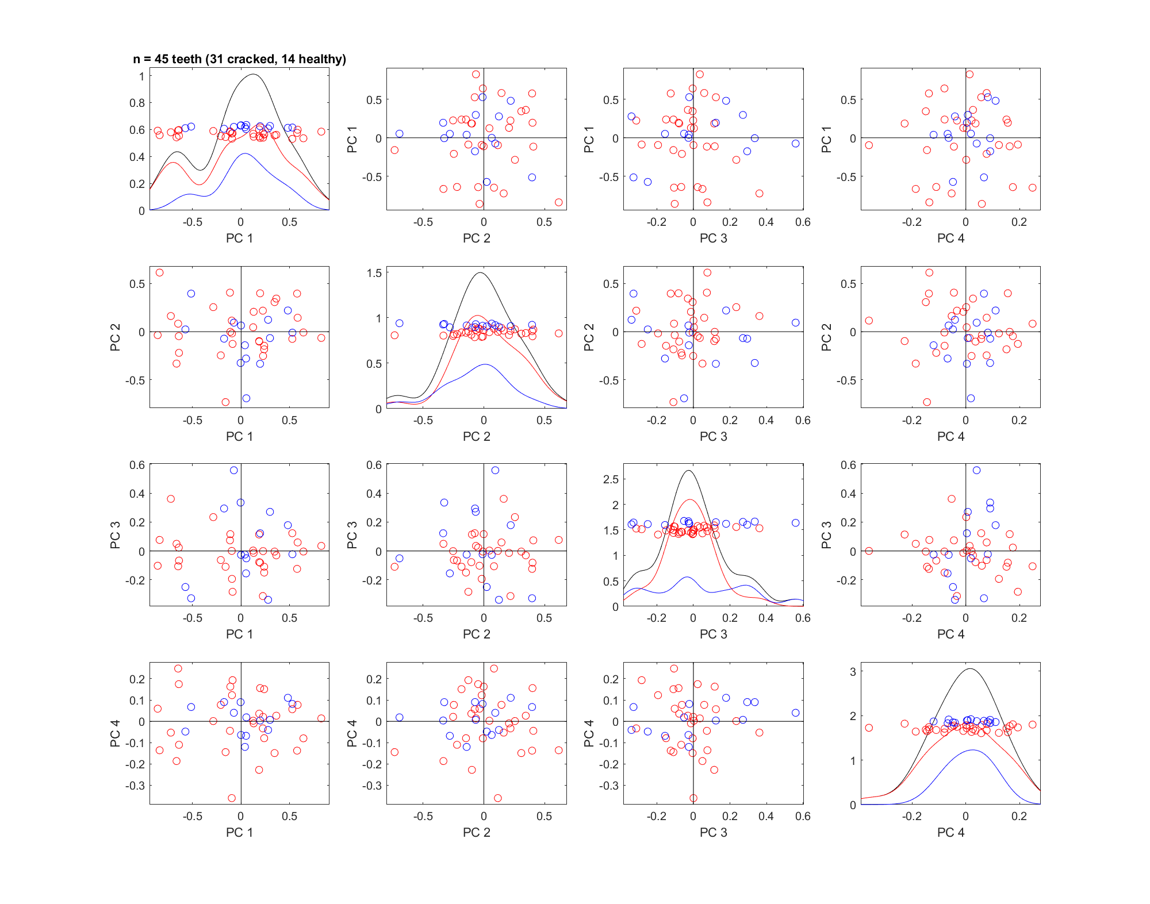
24_PCAScatPlot
log10(quantile)
Use quantiles as features,
number of features = 100
-- use isubpopkde=1 to show curve for each class

Slide 20
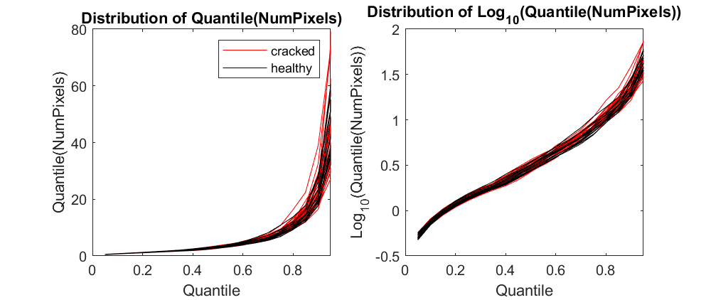
From now on, use quantile to represent each curve
21_rawTrace
Still overlapping distributions
numQuantiles=20 (or should we pick some other number?)

Slide 21
Original quantile
Log10(quantile)
22_curvdatPlot
-- don’t see much trend

Slide 22
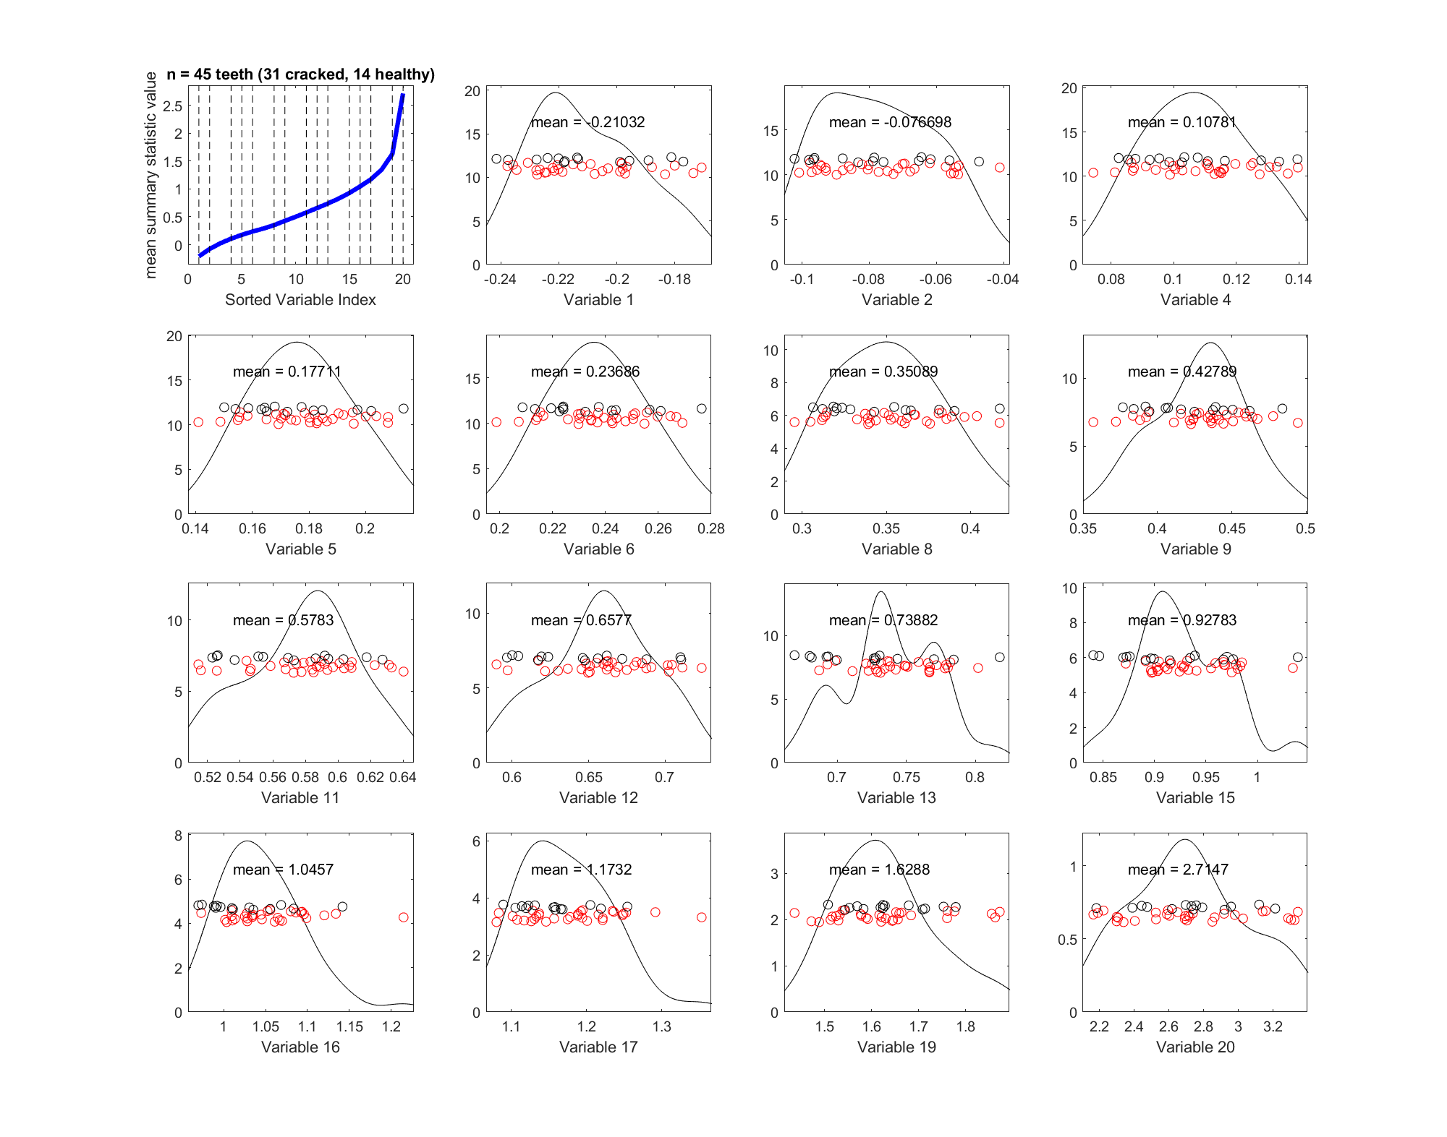
23_margDistPlot
Marginal distribution plot on log10(quantile)
number of features = 20
Summary statistics of mean

Slide 23
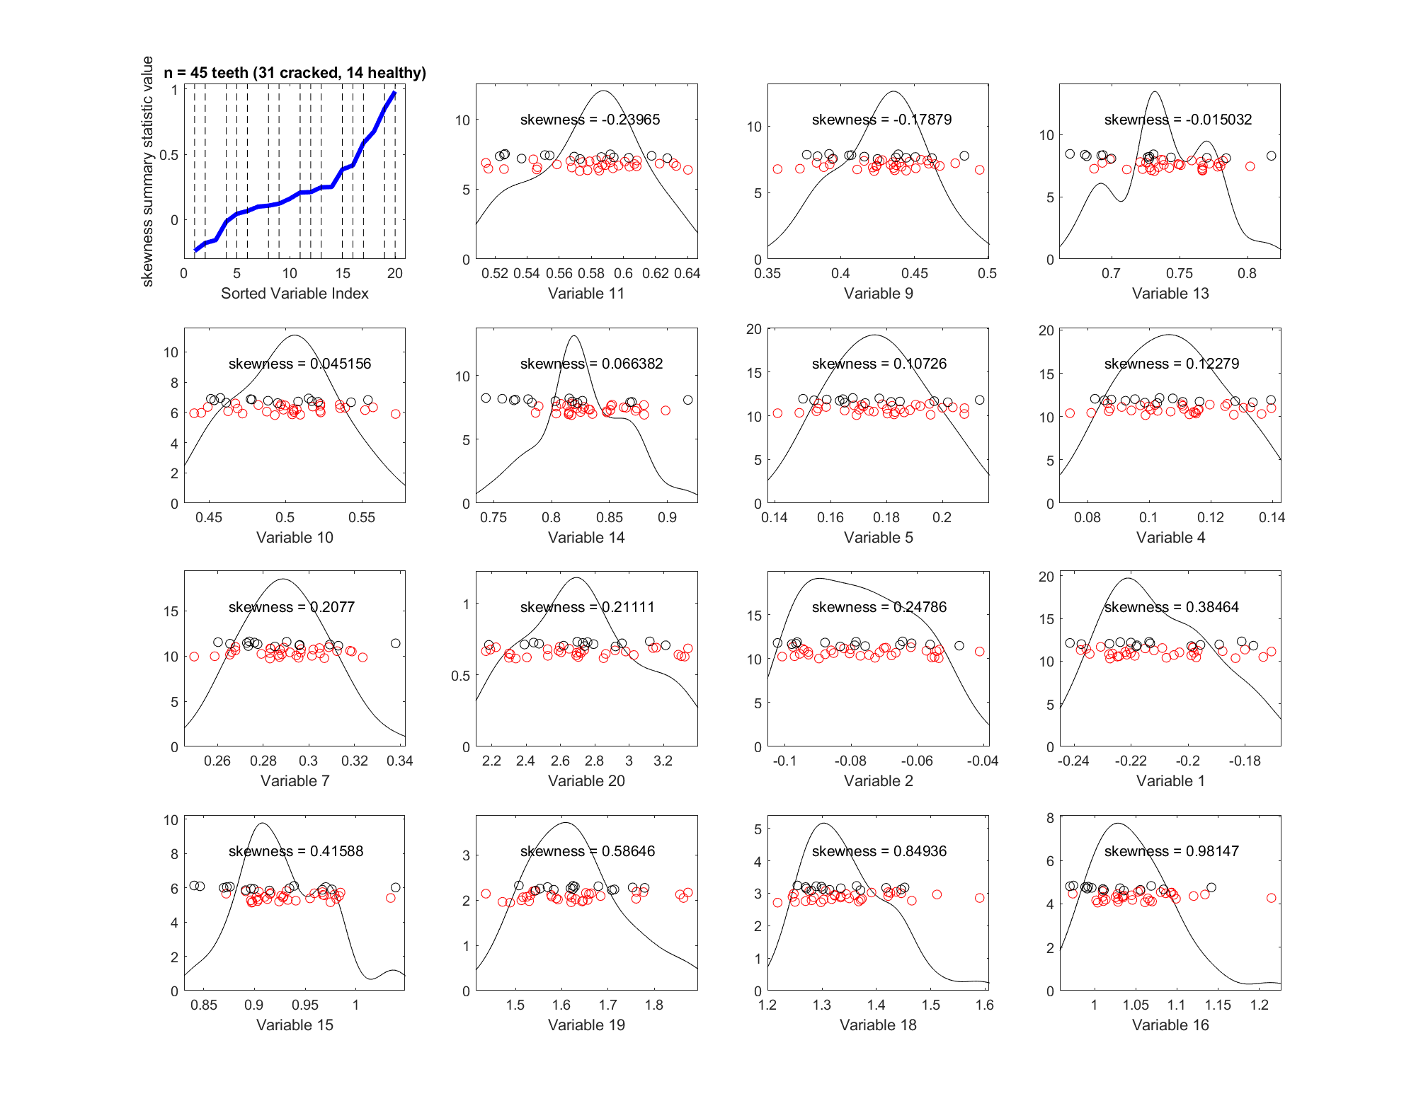
23_margDistPlot
Marginal distribution plot on log10(quantile)
number of features = 315
Summary statistics of skewness
-- hard to separate 2 classes

Slide 24
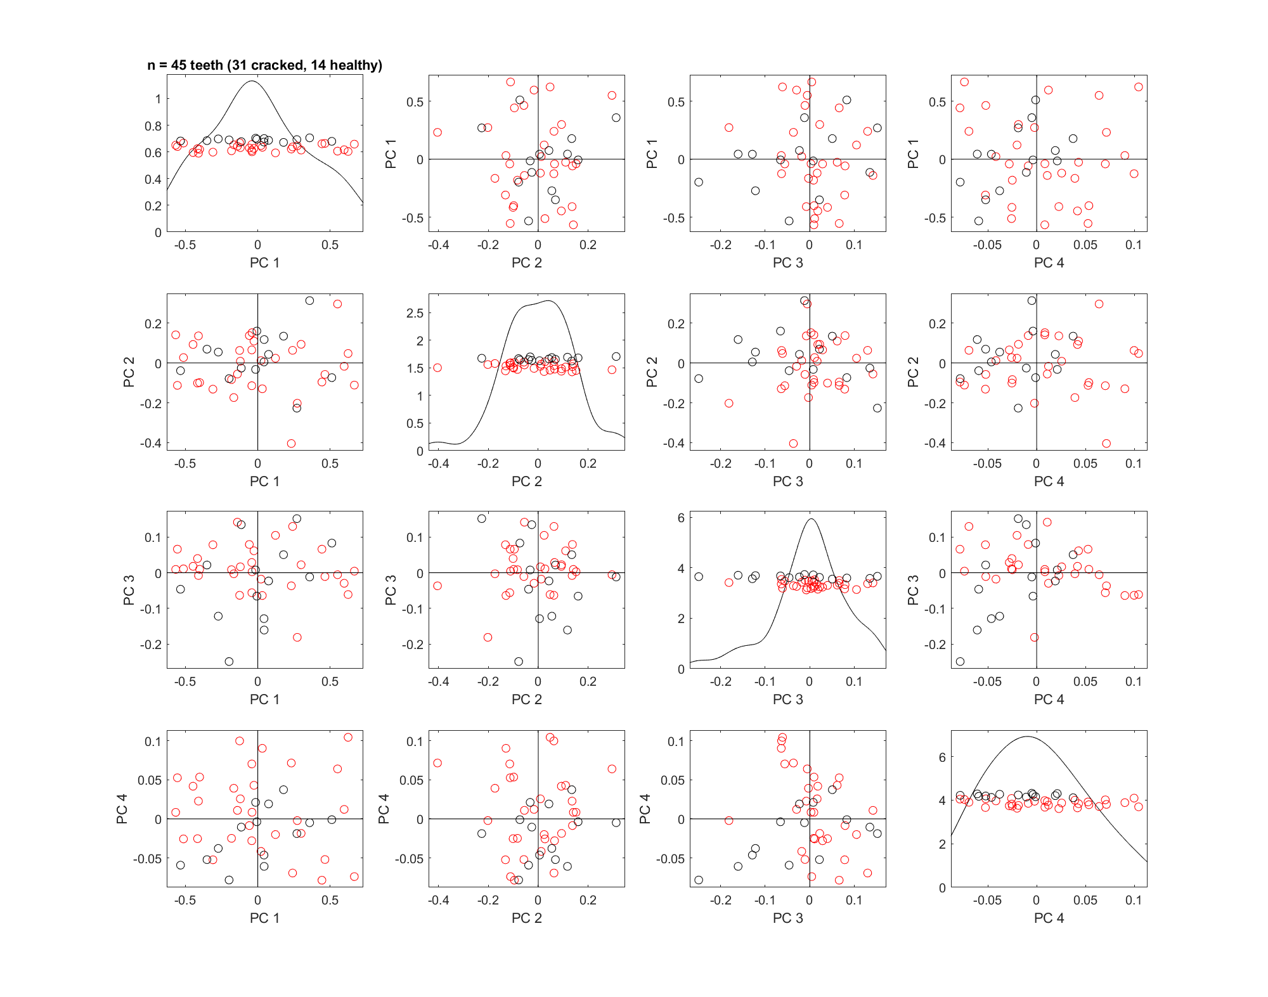
24_PCAScatPlot
log10(quantile)
-- 4 PCs don’t seem to separate the 2 classes
there seems to be some separation happening in PC4

Slide 25
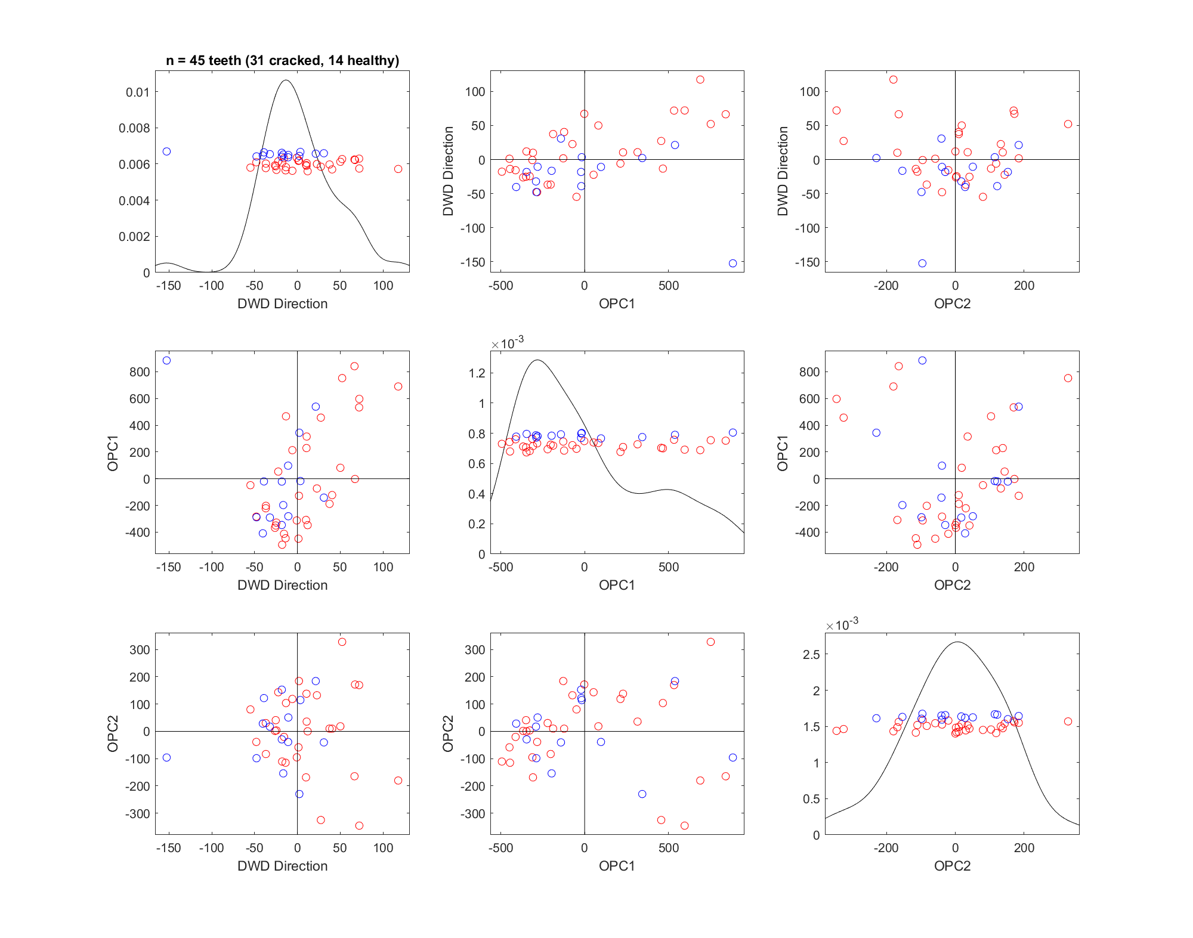
31_DWD_PCAScatPlot
number of features = 315
PCA plot with DWD direction
Some combinations (DWD-PC1 ~ DWD-PC2; DWD-PC1 ~ DWD-PC4) seem to separate the classes a little?

Slide 26
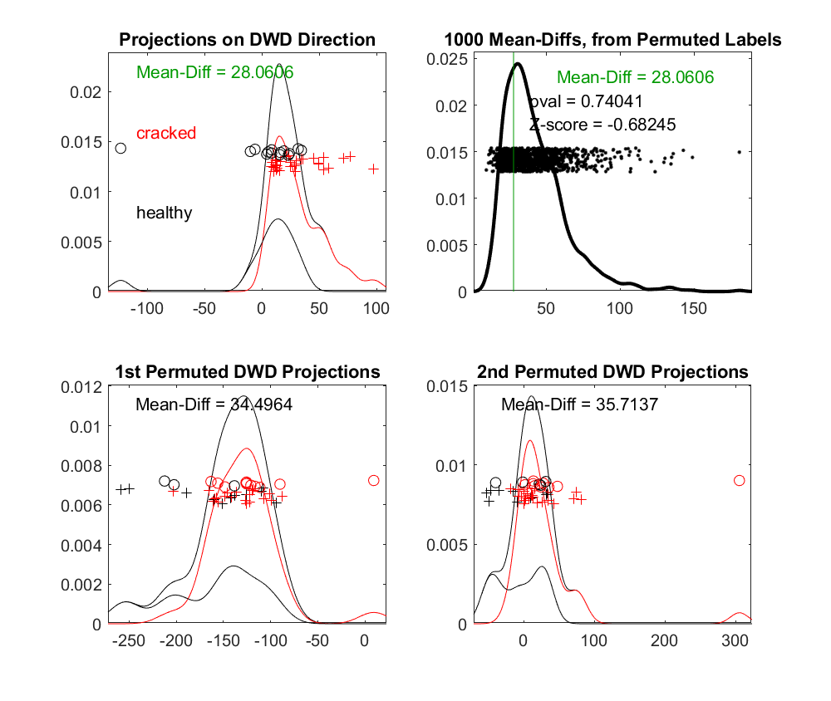
32_DiProPerm_315Features
number of features = 315
DiProPerm test does not show significant separation between 2 classes ☹

Slide 27
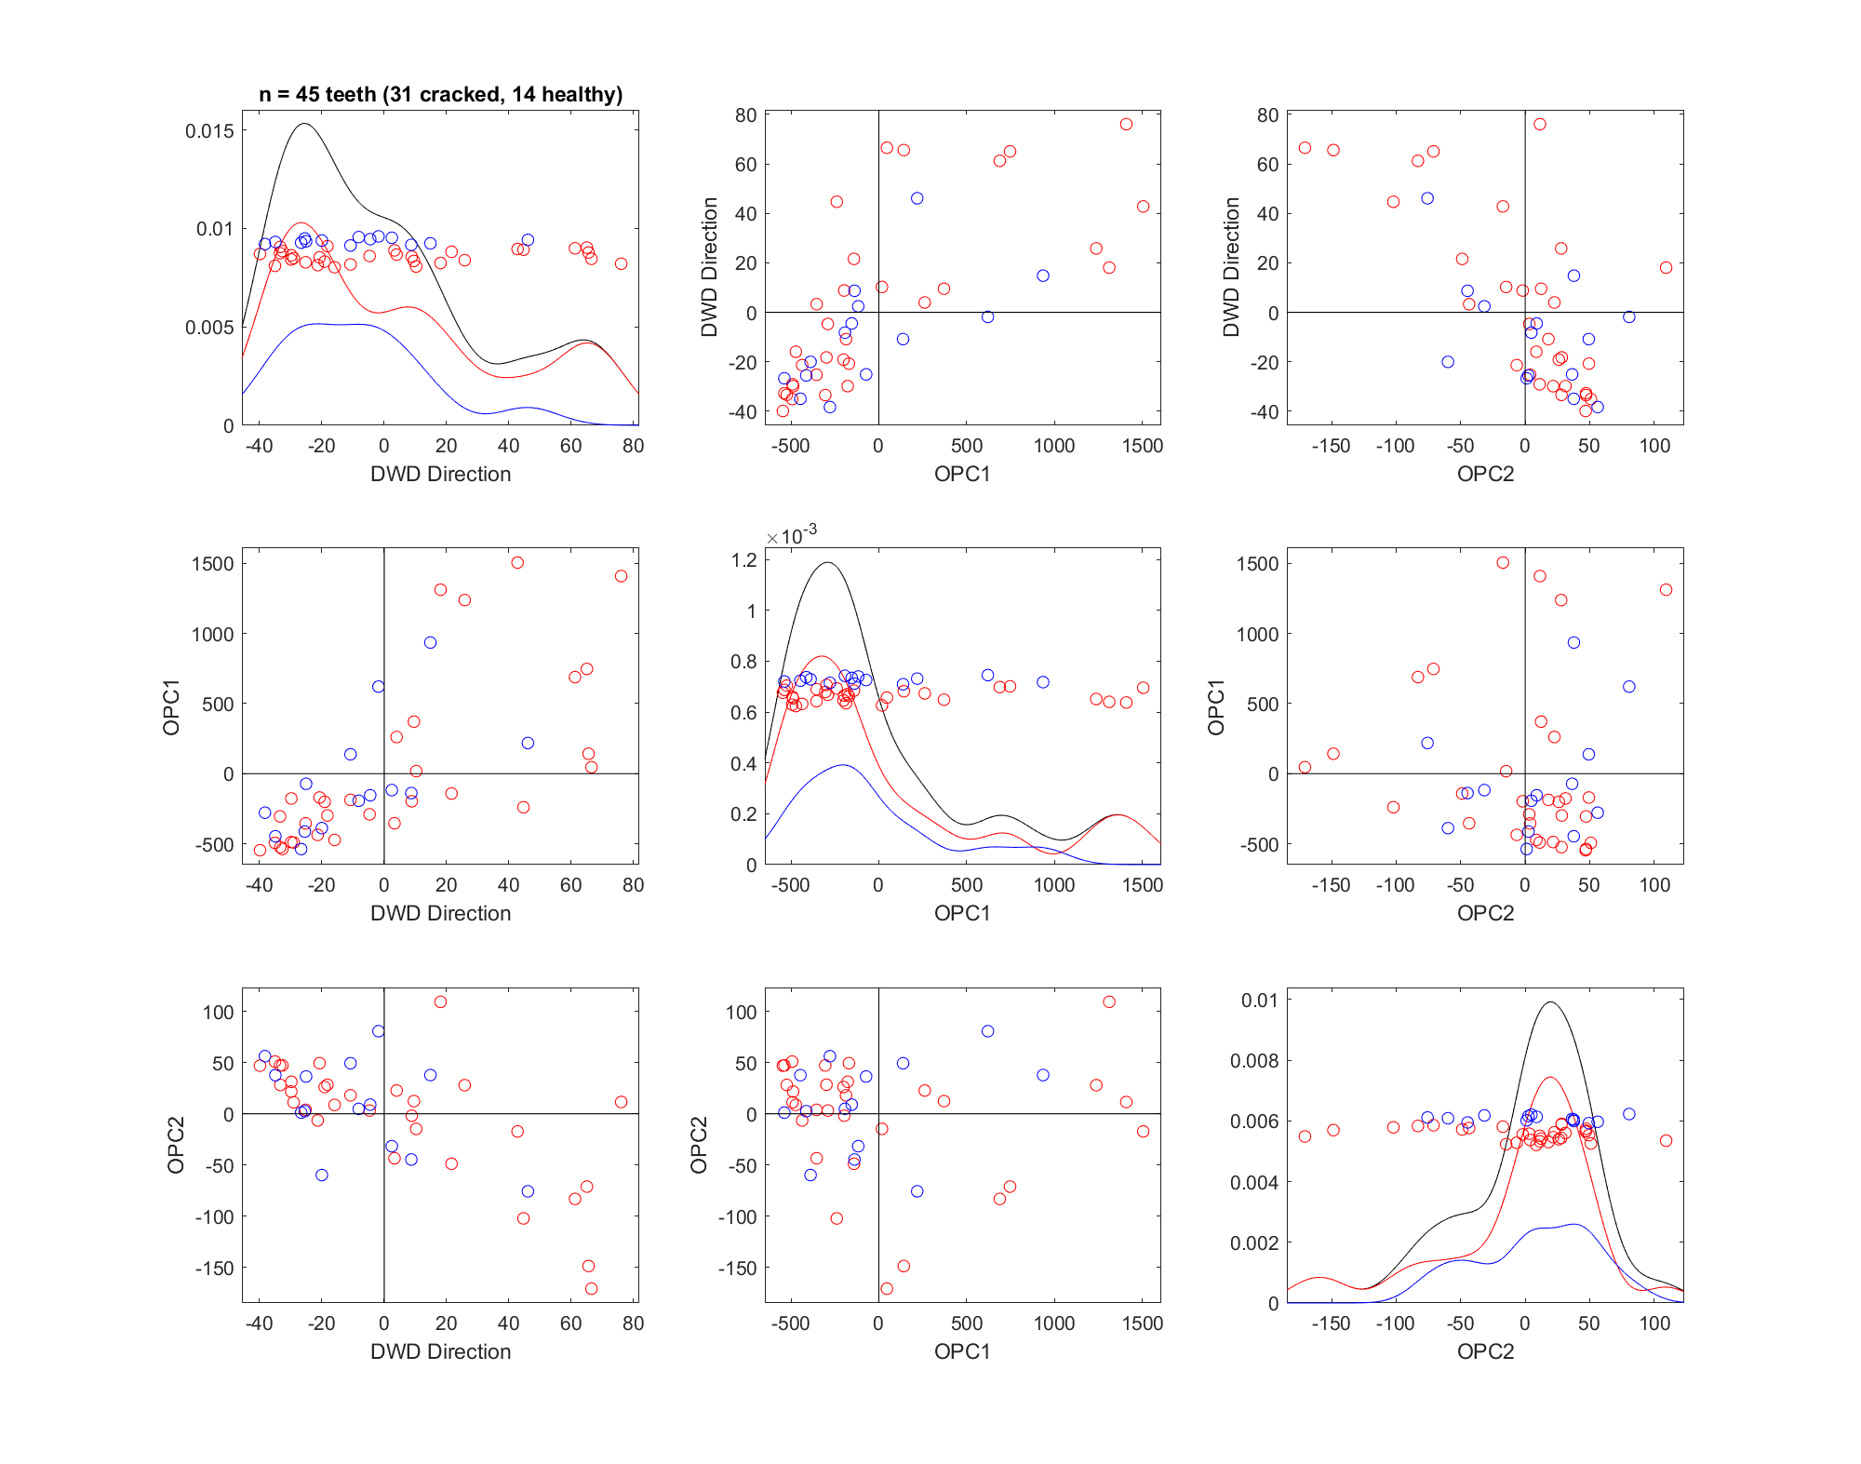
33_DWD_PCAScatPlot
number of features = 100 quantiles
PCA plot with DWD direction
Some combinations (DWD-PC1 ~ DWD-PC2; DWD-PC1 ~ DWD-PC4) seem to separate the classes a little?

Slide 28
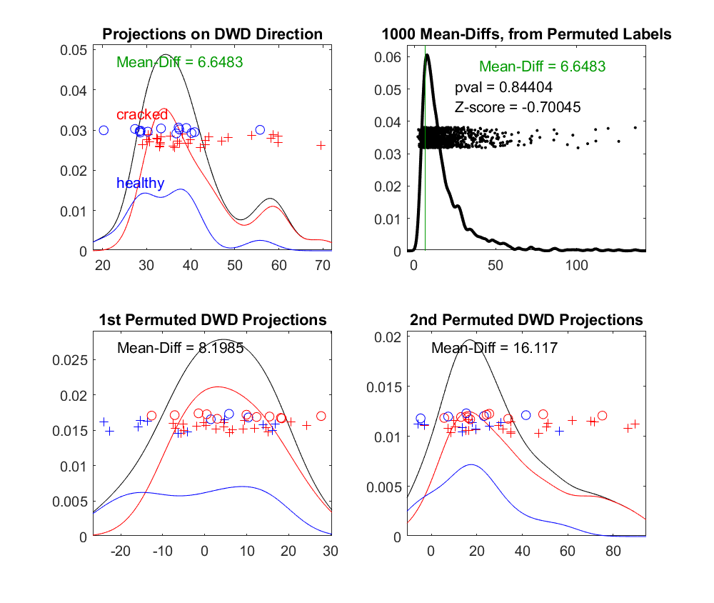
34_DiProPerm_100Features
number of features = 100 quantiles
DiProPerm test does not show significant separation between 2 classes ☹

